Slide 1
Cosmic Background Radiation

Slide 2
By the end of this lesson, you should be able to:
Compare the Big Bang theory and the Steady State Theory.
Explain what the Cosmic Microwave Background Radiation is.

Slide 3

The Big Bang Theory is currently the most well accepted theory for the origins of the universe.
But this was not always the case. The Big Bang Theory is just the most recent in a line of theories.
And someday a new theory may be created which can explain the origin of the universe even better.

Slide 4
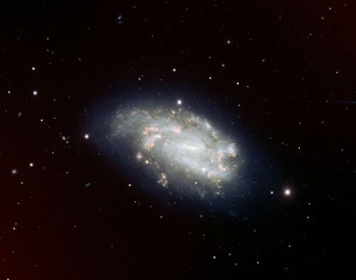
Fifty years ago, the most well accepted theory on the origins of the universe was the Steady State Model.
According to this theory, the universe is infinite in size with no beginning or end.
This theory matched the observation that the galaxies seem to be evenly distributed through space.

Slide 5
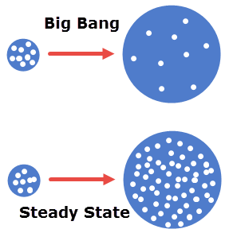
To explain the fact that the galaxies seem to move away from each other, the theory also claimed that new galaxies would appear in the spaces between the old ones.
The replacement would cause the universe to always look the same, despite the movement of the distant stars.

Slide 6
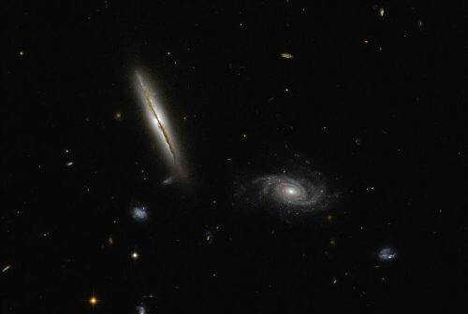
This theory was proposed by Sir Fred Hoyle in 1948, and it was incredibly popular over the next 20-30 years.
By the end of the 1970's, most scientists had rejected it in favour of the Big Bang theory.
This was after years of fierce competition between the theories. Hoyle actually coined the name "Big Bang" when attempting to ridicule the idea, and it stuck.

Slide 7
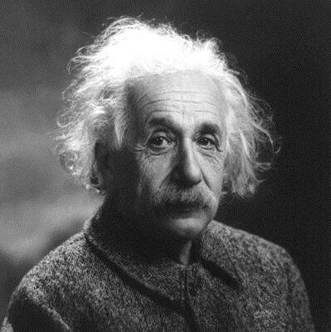
The Big Bang theory was a long time in development.
The first signs of an expanding universe had actually appeared to Albert Einstein in the 1910's.
When devising his theory of general relativity, Einstein found that his equations implied that the universe was expanding.
He actually introduced a term to his equation, the cosmological constant, to avoid what he saw as a deeply unsatisfying conclusion.

Slide 8
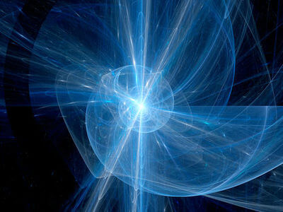
The first version of the Big Bang theory was created in 1927 by Georges Lemaître, a Catholic priest and astronomer.
He published a paper on the expanding universe in a Belgian magazine, but at this stage had no mention of the singularity.

Slide 9
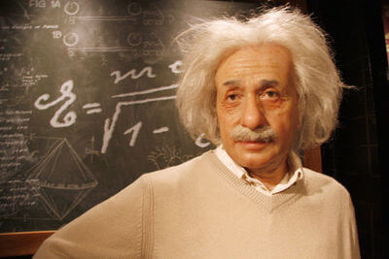
Supported by the observations of Edwin Hubble, Georges Lemaître was able to refine his theory.
In 1933, Lemaître presented his most recent version of the theory, which began with growth from a singularity - a "Cosmic Egg", as he called it.
After hearing the theory, Einstein applauded and announced:
"That was the most beautiful and satisfactory explanation of creation that I have ever heard".

Slide 10
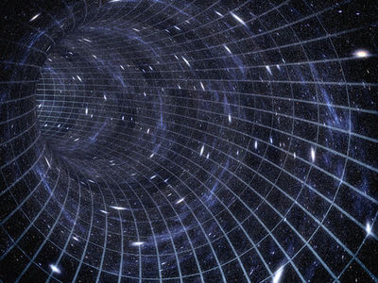
It took many years, but the Big Bang theory eventually became the accepted theory for creation over the Steady State theory.
This is because the evidence and data which appeared over the years supported the Big Bang more than Steady State.

Slide 11
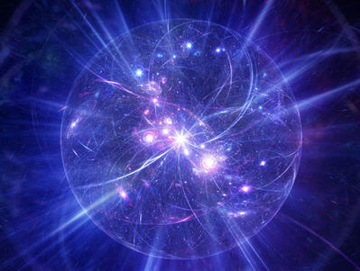
Let's start on the proof of the Big Bang by thinking about what happened during it.
We need to find a point of time which might be detectable today.
We know that at around 300,000 years after the universe began, electrons became bound to nuclei. This was also the first time that photons were not bound to other particles.
They began to travel the universe instead.

Slide 12
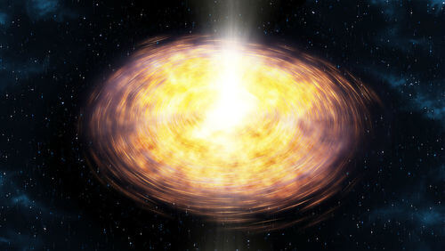
We also know that the universe was very hot at this time, hotter than the Sun.
Hot objects emit light, just as the Sun does.
So overall there should be a very large amount of light emitted from that point in time.
Because this time had so much light, it's known as the photon epoch.

Slide 13
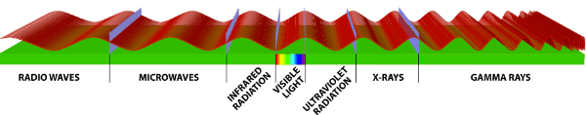
If the universe is expanding, there should still be some of that light travelling to Earth.
This light would be emanating from very far-away points of the universe - anywhere around 13.7 billion light years away, for example.
But the light will be stretched by the expanding universe, increasing its wavelength. So any signal we receive will be radio waves.

Slide 14
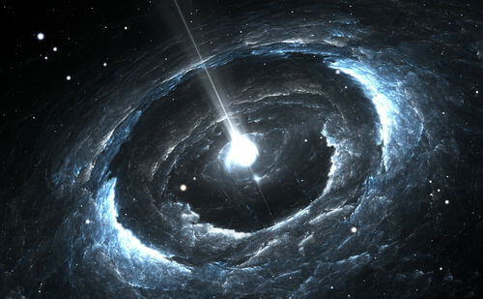
Gamow predicted that the universe would emit an "afterglow" of radiation from the Big Bang because it has a temperature.
The afterglow was named "cosmic microwave background radiation".

Slide 15
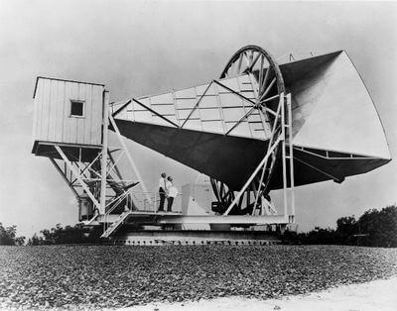
Despite the predictions, no evidence for cosmic microwave background radiation (CMB radiation) was found until 1965.
Two American astronomers, Arno Penzias and Robert Wilson, were working on measuring radio signals from the Milky Way.
But there was an annoying background signal that was interfering with their measurements.

Slide 16
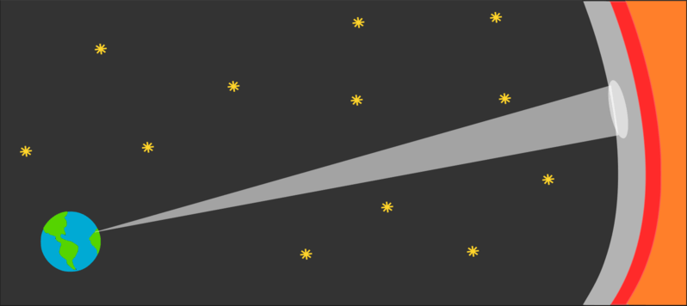
When they tried to find the source of the signal, they realised that the signal was coming from everywhere at once.
Every point in the sky was producing the same background radiation signal.
A cosmologist, Bob Dicke, was able to confirm: this signal was the CMB radiation.

Slide 17
